Slide 1
MUN Resolutions

Slide 2
What is a resolution?
A resolution is a document in which you propose solutions to the problem. It is an action plan.
It is the result of a group of like-minded delegates who collaborate on one topic in order to come up with a comprehensive solution. (LOBBYING AND MERGING)

Slide 3
What is the format of a resolution?
2 parts:
The preambulatory clauses: gives background to the topic; answers “Why?”. Use hard facts like statistics
The operative clauses: proposes solutions to the problem; answers the questions “What? How?” etc.. Don’t be vague, this is the chance to show real answers. Use sub-clauses.

Slide 4
How do I write one?
Research your country’s stance on the issue. You represent your country, not your own opinions.
How does your country feel about the topic? What do you feel your country is doing about it?
What are the arguments against your country’s stance? Can you disprove them?

Slide 5
How is it going to be debated?
If you are the Main Submitter, you first read out the operative clauses, then explain to everyone why you think the resolution is good; summarize the main points
You are going to be asked questions. Prepare yourself to answer them.

Slide 6
Anything else?
There is a list of specific initiating phrases you have to use at the beginning of each clause. You always have to use these. Note that binding words like “decides” or “demands” is not allowed (except for SC)
A resolution is ONE long sentence. There are NO full stops until the end.
Do not be unrealistic. Use good solutions, but that you believe can actually be implemented.

Slide 8
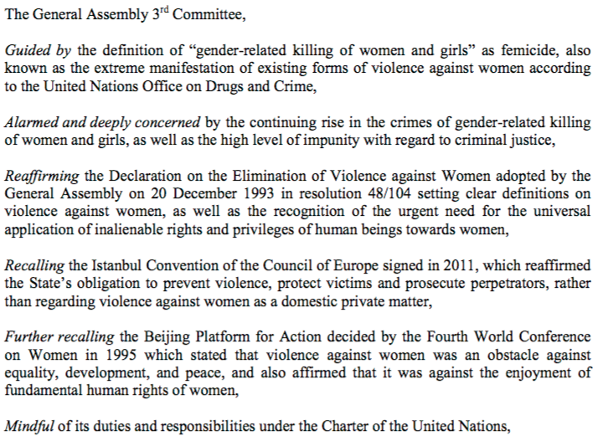

Slide 9
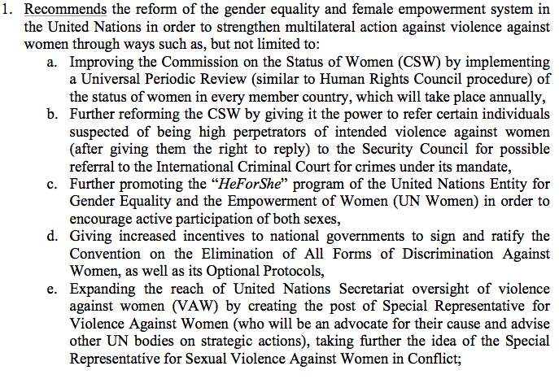

Slide 10
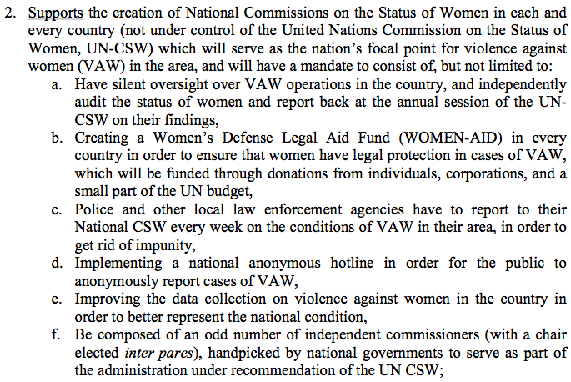

Slide 11
